Slide 1
Propositional Logic

Slide 2
Logic is the study of reasoning. The British mathematician George Boole (1815-1864) is the man who made logic mathematical. Logic can be used in programming and it be applied to the analysis and automation of reasoning about software and hardware. This is why it is considered a part of theoretical computer science. Since reasoning plays an important role in intelligent behaviour, logic is closely related to artificial intelligence.

Slide 3
Truth Tables
The goal of this section is to understand both mathematical conventions and the basics of mathematical reasoning. We will learn how to think and write like a mathematician and we drop some formalisation until we familiarise ourselves with convention. For a given statement P, we will look at the possible truth values of P. Namely, either P is True or P is False.

Slide 4
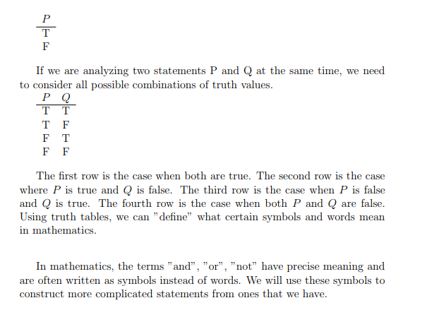

Slide 5
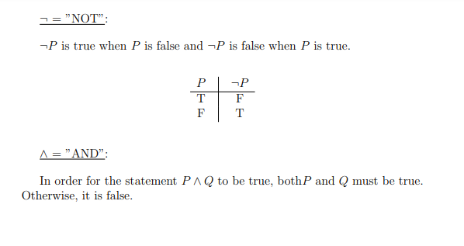

Slide 6
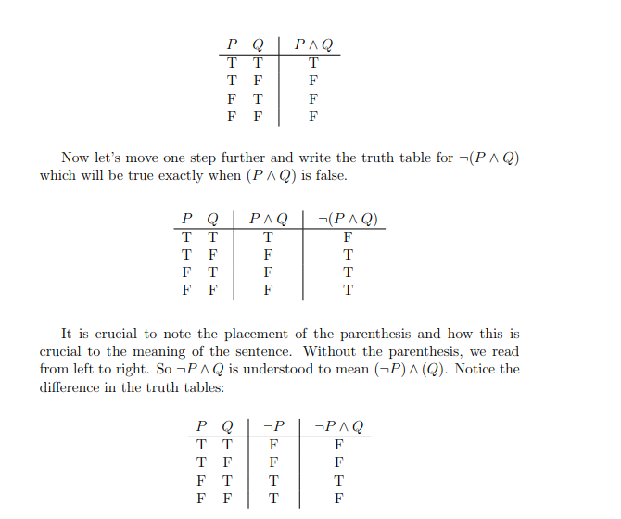

Slide 7
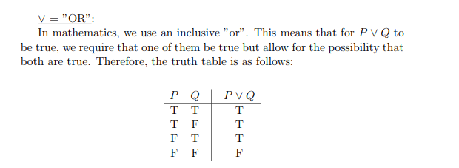
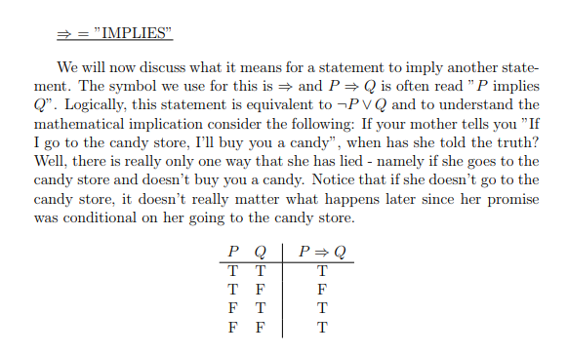

Slide 8
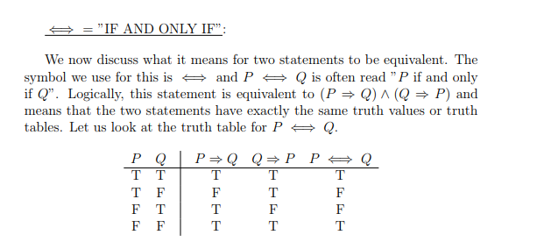

Slide 9
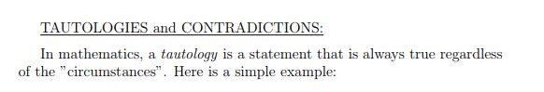
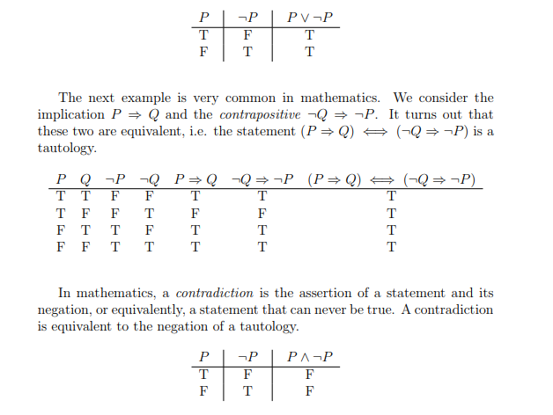

Slide 10
Exercises
Use a truth table to verify that the following are equivalent formulas:
F ⋀ (G ⋁ H) ∼(F ⋀ G) ⋁ (F ⋀ H)
F ⋁ (G ⋀ H) ∼(F ⋁ G) ⋀ (F ⋁ H)
De Morgan's Law
3. ⅂ (F ⋀ G) ∼ ⅂F ⋁ ⅂G
4. ⅂ (F ⋁ G) ∼ ⅂F ⋀ ⅂G

Slide 11
(1)
F ⋀ (G ⋁ H) ∼(F ⋀ G) ⋁ (F ⋀ H)
F | G | H | (G ⋁ H) | F⋀(G ⋁ H) | (F ⋀G) | (F ⋀H) | (F ⋀G)⋁(F ⋀H)
F | F | F | F | F | F | F | F
F | F | T | T | F | F | F | F
F | T | F | T | F | F | F | F
F | T | T | T | F | F | F | F
T | F | F | F | F | F | F | F
T | F | T | T | T | F | T | T
T | T | F | T | T | T | F | T
T | T | T | T | T | T | T | T

Slide 12
(2)
F ⋁ (G ⋀ H) ∼(F ⋁ G) ⋀ (F ⋁ H)
F | G | H | (G ⋀H) | F⋁(G ⋀H) | (F ⋁G) | (F ⋁H) | (F ⋁G)⋀(F ⋁H)
F | F | F | F | F | F | F | F
F | F | T | F | F | F | T | F
F | T | F | F | F | T | F | F
F | T | T | T | T | T | T | T
T | F | F | F | T | T | T | T
T | F | T | F | T | T | T | T
T | T | F | F | T | T | T | T
T | T | T | T | T | T | T | T

Slide 13
(3)
⅂ (F ⋀ G) ∼ ⅂F ⋁ ⅂G
F | G | (F ⋀G) | ⅂(F ⋀G) | ⅂F | ⅂G | ⅂F ⋁ ⅂G
F | F | F | T | T | T | T
F | F | F | T | T | T | T
F | T | F | T | T | F | T
F | T | F | T | T | F | T
T | F | F | T | F | T | T
T | F | F | T | F | T | T
T | T | T | F | F | F | F
T | T | T | F | F | F | F

Slide 14
(4)
⅂ (F ⋁ G) ∼ ⅂F ⋀ ⅂G
F | G | (F ⋁G) | ⅂(F ⋁G) | ⅂F | ⅂G | ⅂F ⋁ ⅂G
F | F | F | T | T | T | T
F | F | F | T | T | T | T
F | T | T | F | T | F | F
F | T | T | F | T | F | F
T | F | T | F | F | T | F
T | F | T | F | F | T | F
T | T | T | F | F | F | F
T | T | T | F | F | F | F

Slide 15
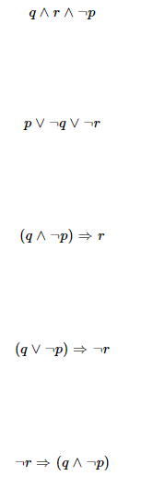
Exercise: Construct truth tables for the following propositions:

